Slide 1
CM1605 Web Technology
Introduction to HTML II
Week 2 | Janani Harischandra

Slide 2
Learning Outcomes
Covers LO2 for Module
On completion of this lecture, students are expected to be able to:
Understand and describe HTML Tables, Images, Image maps, HTML Graphics , Colors, Audio/Video Tags, HTML entities.
Design hypertext documents using HTML Tables, Images, Image Maps, HTML Audio/Video Tags.

Slide 3
Content
HTML Tables
Colors
Images
Image Maps
Audio/Video
HTML entities and special characters
HTML Graphics
HTML5 Tags
Troubleshooting

Slide 4
HTML Tables
A table represents information in a grid format.
There are several types of information that need to be displayed in a grid or table.
Eg: sports results, stock reports, train time tables, financial reports etc.

Slide 5

HTML Table Example

Slide 6
Basic HTML Table Structure
<table>
is used to create a table. The contents of the table are written out row by row.
<tr>
The start of each row using the opening <tr> tag.
<td>
Each cell of a table is represented using a <td> element.
The <td> elements are the data containers of the table.
They can contain all sorts of HTML elements; text, images, lists, other tables, etc.
<th>
Represent the heading for either a column or a row.
The text in <th> elements are bold and centered.

Slide 7
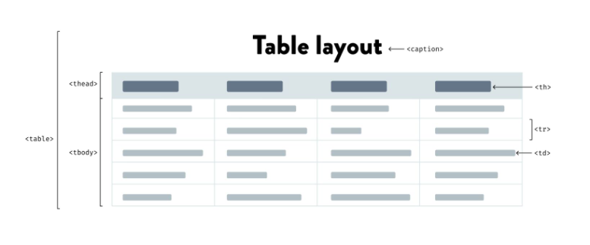
HTML Table Layout

Slide 8
HTML Tables Attributes
colspan - To make a cell span more than one column
rowspan - To make a cell span more than one row
<table border=“2”> - To add a border to a table
<table cellpadding="2” cellspacing=“3”> - Specifies the space between the cell content and its borders
<td align=“left” align=“top”> - To align the content

Slide 9
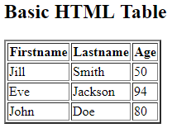
Table Example
<!DOCTYPE html>
<html>
<body>
<h2>Basic HTML Table</h2>
<table border="2">
<tr>
<th>Firstname</th>
<th>Lastname</th>
<th>Age</th>
</tr>
<tr>
<td>Jill</td>
<td>Smith</td>
<td>50</td>
</tr>
<tr>
<td>Eve</td>
<td>Jackson</td>
<td>94</td>
</tr>
</table>
</body>
</html>

Slide 10
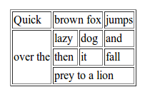
Exercise – HTML Code?

Slide 11
HTML Colors
HTML colors can be specified with predefined,
Color names - <h1 style="background-color:Orange;">Orange</h1>
RGB - rgb(255, 99, 71)
HEX - #ff6347
HSL - hsl(9, 100%, 64%)
RGBA - rgba(255, 99, 71, 0.5)
HSLA -hsla(9, 100%, 64%, 0.5)

Slide 12
HTML Colors
Criteria | HTML Markup | Formatted Text
Background Color | <h1 style="background-color:DodgerBlue;">Hello World</h1>
Text Color | <h1 style="color:Tomato;">Hello World</h1>
Border Color | <h1 style="border:2px solid Tomato;">Hello World</h1>

Slide 13

HTML Images
The HTML <img> tag is used to embed an image in a web page.
The <img> tag creates a holding space for the referenced image.
The <img> tag has two required attributes:
src - Specifies the path to the image
alt - Specifies an alternate text for the image
The HTML <img> Syntax

Slide 14

HTML Image Attributes
Attribute | Meaning
alt | - The required alt attribute provides an alternate text for an image, if the user for some reason cannot view it (because of slow connection, an error in the src attribute, or if the user uses a screen reader).This attribute is required in html5.
src | The image URL. This attribute is mandatory
height | Set the height of the image to
width | Set the width of the image
HTML Markup | Formatted Text
<img src="html5.gif" alt="HTML5 Icon" style="width:128px;height:128px;">

Slide 15
HTML Images - Rules
It is good practice to create a folder for all of the images a website site uses.
If you have your images in a sub-folder, you must include the folder name in the src attribute:
Some web sites store their images on another server.
There are three rules to remember when you are adding images for your website
Image format (Jpeg, GIF, PNG)
Image size
Image location

Slide 16
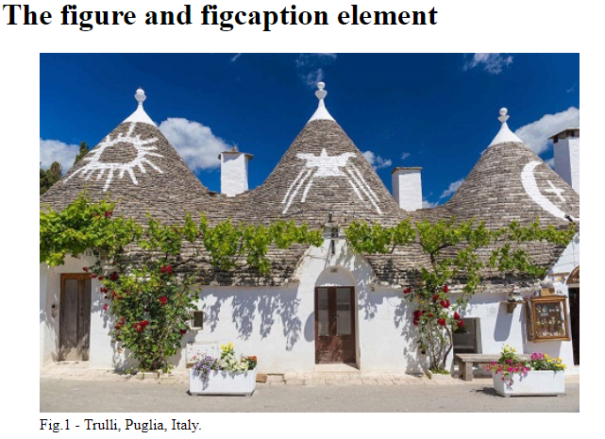
HTML <figure> Tag
A <figure> element can be used to mark up a photo in a document, and a <figcaption> element to define a caption for the photo.
HTML Markup | Formatted Text
<!DOCTYPE html> <html> <body> <h1>The figure and figcaption element</h1> <figure> <img src="pic_trulli.jpg" alt="Trulli" style="width:100%"> <figcaption>Fig.1 - Trulli, Puglia, Italy.</figcaption> </figure> </body> </html>

Slide 17
HTML Image Maps
The HTML <map> tag defines an image map. An image map is an image with clickable areas.
These clickable areas are defined with one or more <area> tags.
The image is displayed using the usual <img> tag. Eg: Click Here.
HTML Markup
<!DOCTYPE html> <html> <body> <h2>Image Maps</h2> <p>Click on the computer or the phone to go to a new page and read more about the topic: </p> <img src="workplace.jpg" alt="Workplace" usemap="#workmap" width="400" height="379"> <map name="workmap"> <area shape="rect" coords="34,44,270,350" alt="Computer" href="computer.htm"> <area shape="rect" coords="290,172,333,250" alt="Phone" href="phone.htm"> </map> </body> </html>

Slide 18
HTML Audio/Video
Before HTML5, audio/video files could only be played in a browser with a plug-in (like flash).
Audio and Video can contain one or many <source> tags with different sources. The browser will choose the first source it supports.
The controls attribute adds audio controls, like play, pause, and volume.
HTML Markup
<video width="320" height="240" controls> <source src="movie.mp4" type="video/mp4"> <source src="movie.ogg" type="video/ogg"> Your browser does not support the video tag. </video> <audio controls> <source src=“song1.mp3" type="audio/mpeg"> </audio>

Slide 19
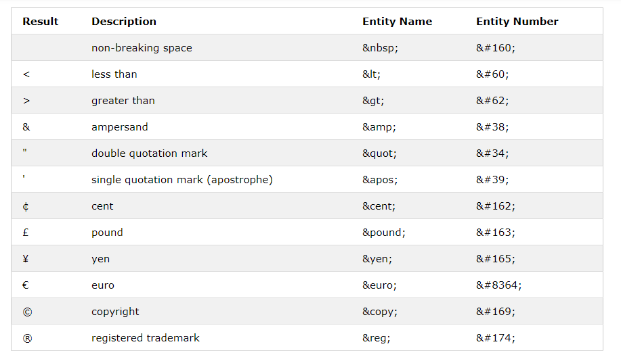
HTML Entities & Special Characters
Reserved characters in HTML must be replaced with character entities.
If you use the less than (<) or greater than (>) signs in your text, the browser might mix them with tags.
Therefore, character entities should be represented with &entity_name OR & #entity_number.

Slide 20


HTML Graphics
HTML Graphics | Example | Purpose
SVG |  | The HTML <svg> element allows vector based graphics in HTML SVG is used to define vector-based graphics for the Web.
Canvas |  | The HTML <canvas> element can be used to draw graphics on a web page: The <canvas> element is only a container for graphics. You must use a JavaScript to actually draw the graphics.

Slide 21
HTML5 Layout Tags
HTML5 has introduced a new set of elements that help define the structure of a page.
<article>
<aside>
<details>
<figcaption>
<figure>
<footer>
<header>
<main>
<mark>
<nav>
<section>
<summary>
<time>

Slide 22
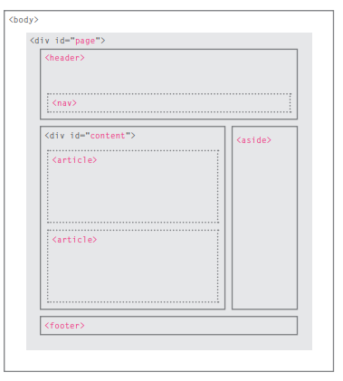
HTML5 Page Structure

Slide 23
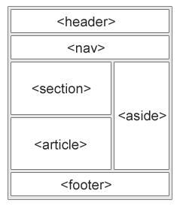
HTML5 Semantic Tags
A semantic element clearly defined its content and meaning to both the browser and the developer.
Non-semantic elements: Eg:<div>,<span>
Semantic elements: Eg:<form>, <table>, and <article>

Slide 24
Troubleshooting
The websites should be thoroughly tested to avoid problems such as:
Typos
HTML must be exact in order to work correctly.
A single mistyped or missing character can reek havoc in your webpages.
Broken Links
If a user clicks on a link and it doesn’t take them where you intend, it is considered a “broken link”.
Missing Images
Check that the path and file name of the image is exactly correct, including the file extension (.jpg, .gif, etc.)

Slide 25
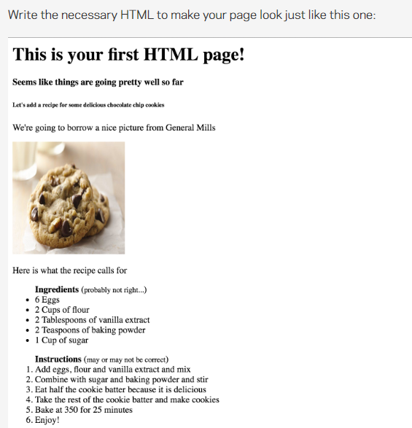
Exercise

Slide 26
Reading
Duckett, J. (2011), HTML & CSS, Design and Build Websites, Wiley.
Castro & Hyslop, B.(2011), HTML5&CSS: Visual QuickStart Guide, Peachpit Press.
Robbinson, J . (2018), Learning Web Design, A Beginner’s Guide to HTML,CSS, JavaScript, And Web Graphics, O’Reilly.
Online :
http://www.w3schools.com/html/

